Slide 1

Learn to prompt for continual learning
Submitted by:
Rohit Kumar 20963
Avnish Kumar 20964

Slide 2
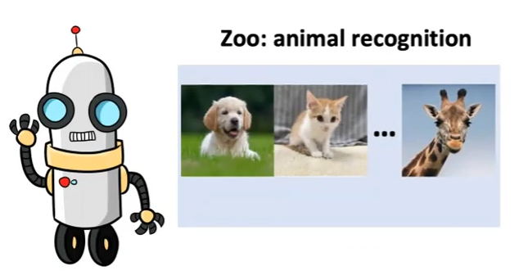
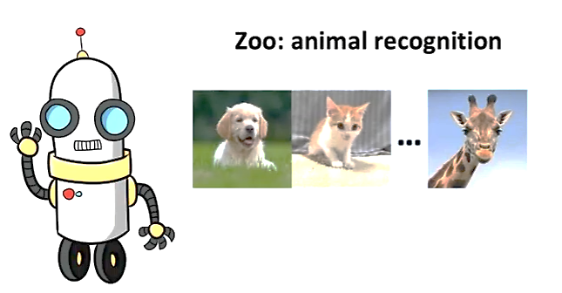
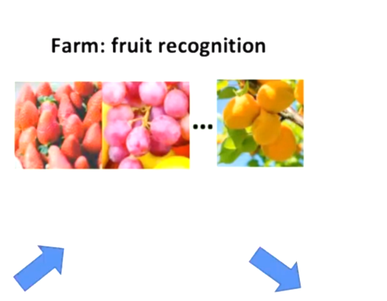
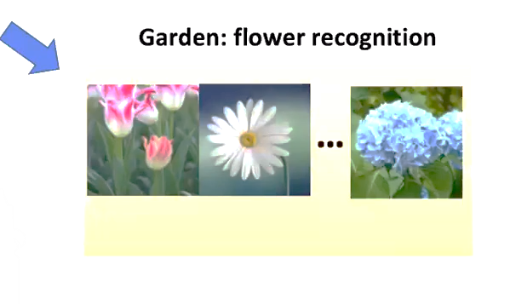
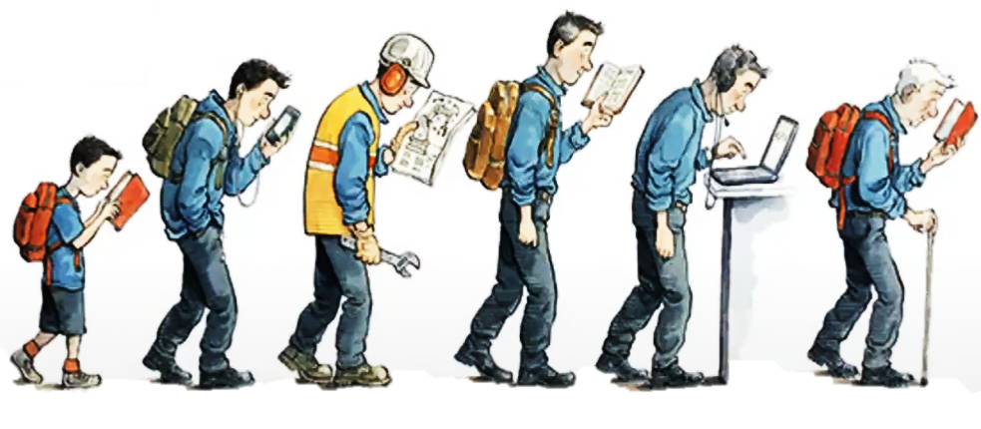
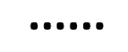
Motivation
Lets start with introduction to continual learning, Its actually the ability of human beings to adapt to diff tasks without forgetting previously learnt tasks, and we can also leverage knowledge learn from past task to tackle new task we would also like this ability for our ML models
>
Lets say we want to train our model on diff tasks

Slide 3
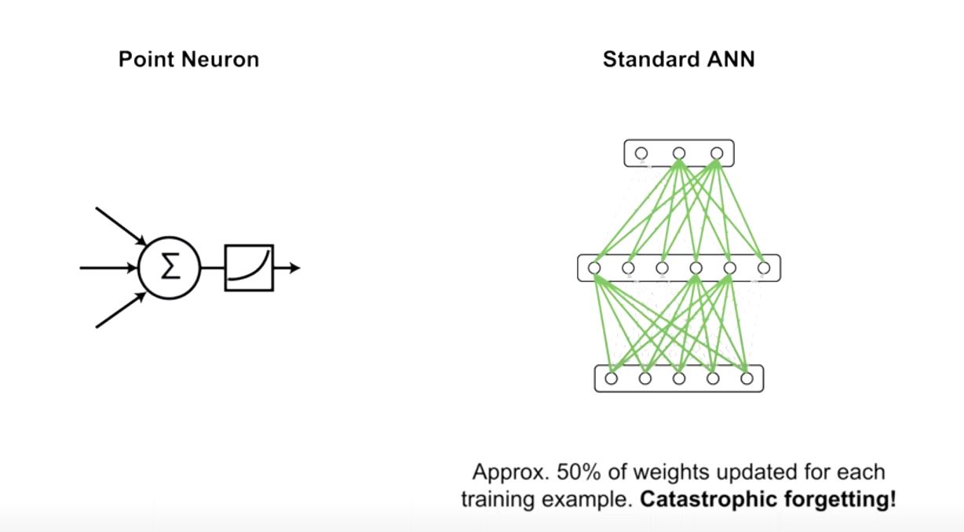
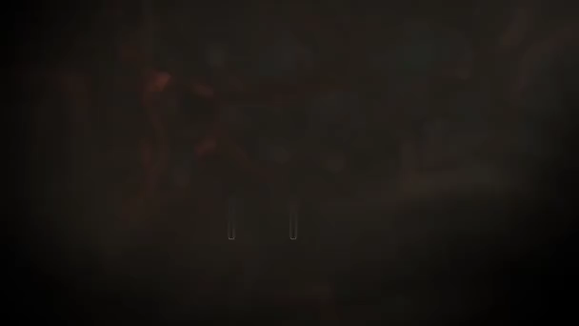
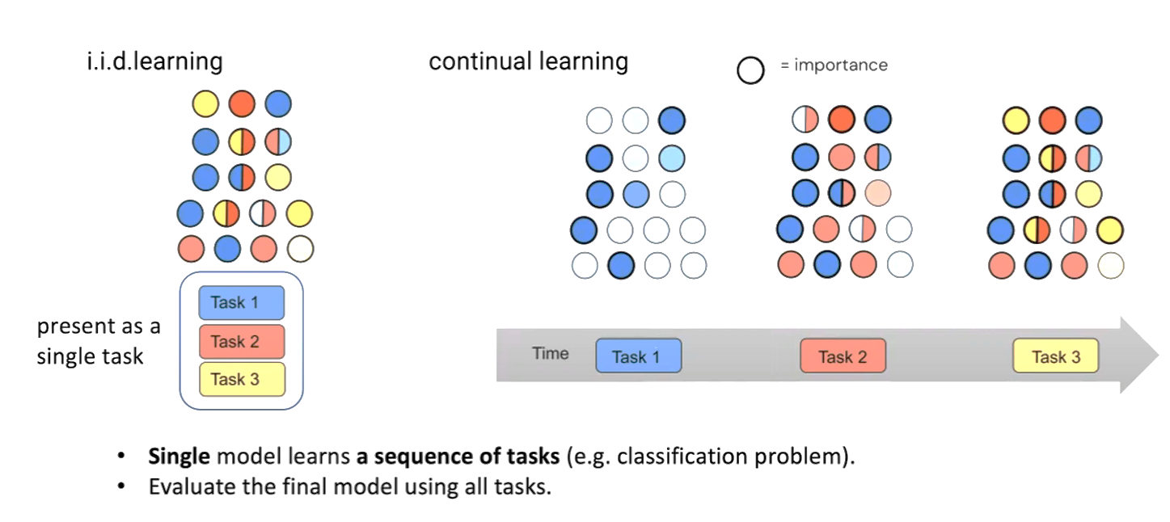
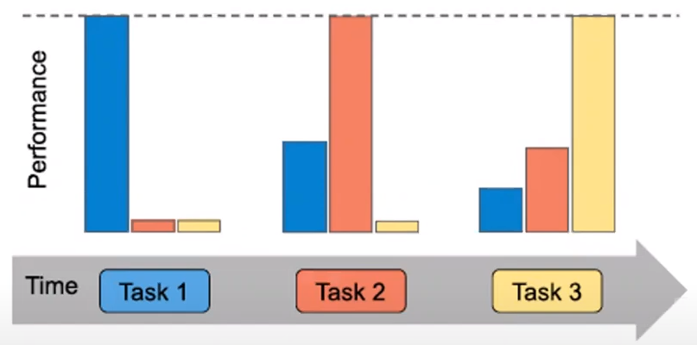
Catastrophic forgetting
Lets take a formal route to Continual learning, the basic idea is to make a single model perform well on seq of tasks.
> We take each task as Conventional supervised classification problem. N finally we would like our model to perform well on all tasks.
SO we would like to evaluate the model on all tasks.
> Here, we have kind of comparison between IID setting, where we don’t have idea of different tasks as all data is available at once.
In CL, we have the concept of time line, so model will be trained on each task on diff time stamp. So the model wil be available for current data from current task
*So we are trying to fit diff task one by one.
When we train on task 3 it performs very well on that task but forget previous task
MAINSTREAM SOLUTION:
Regularization based: we have regulizer that constraint imp parameter: Performance not satisfactory.
Rehearsal based: One of the best performing, here, concept of buffer from previous data.: Data privacy, performance detoriates with small buffer.
Architecture based: You have task specific comp, and Task ID is used to tarin them:
We need task ID for test time, and more tasks means more parameters
Credit: Going beyond the point neuron

Slide 4
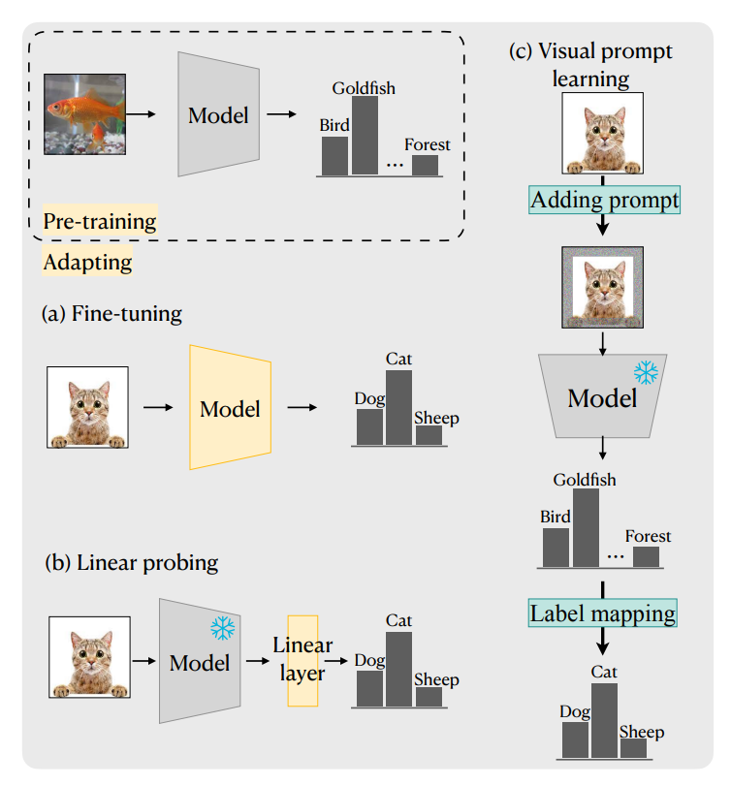
Credit: From Visual Prompt Learning to Zero-Shot Transfer: Mapping Is All You Need
Learning technique

Slide 5
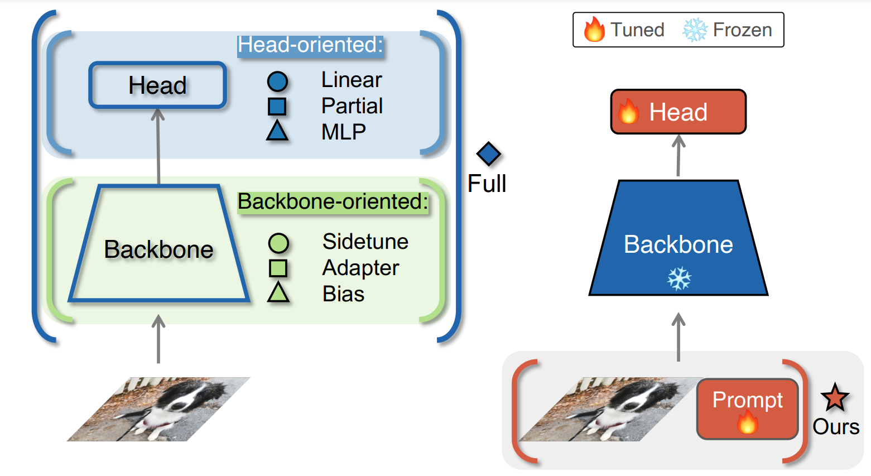
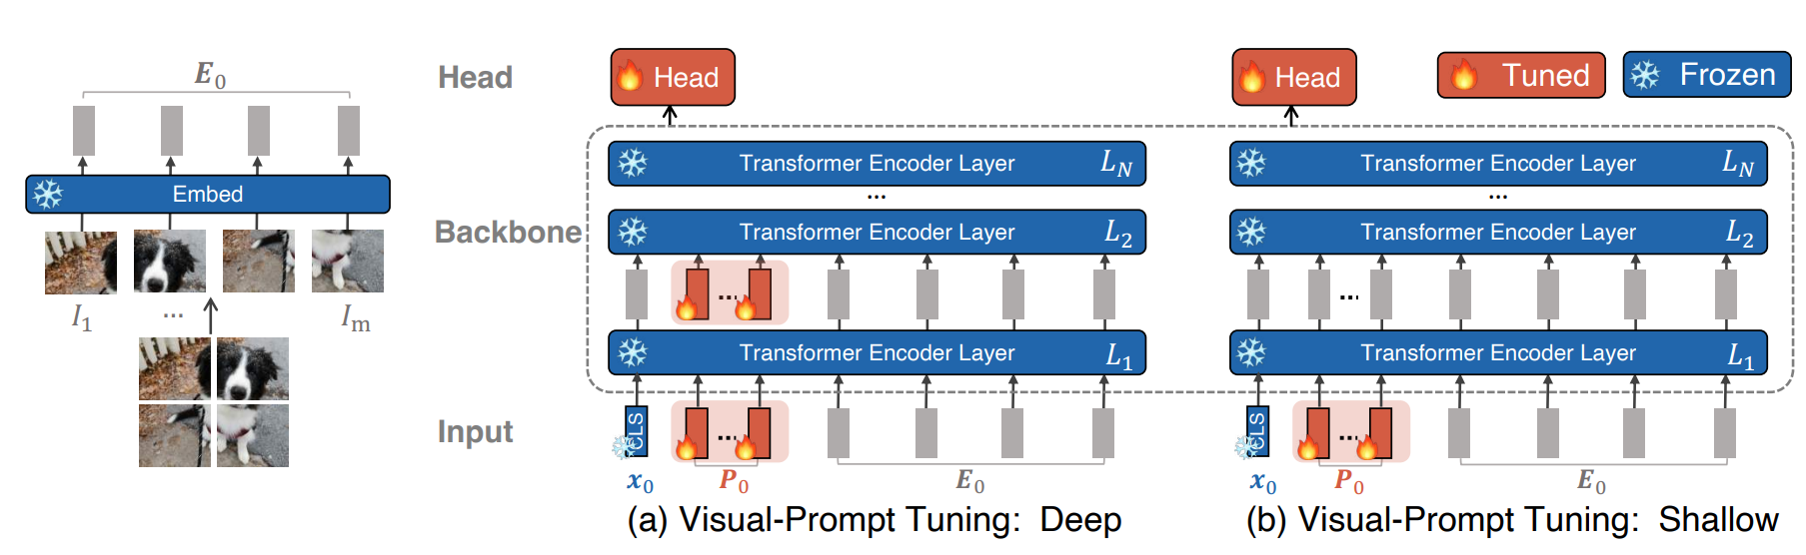
Prompt in ViT
Credit: Visual Prompt Tuning

Slide 6
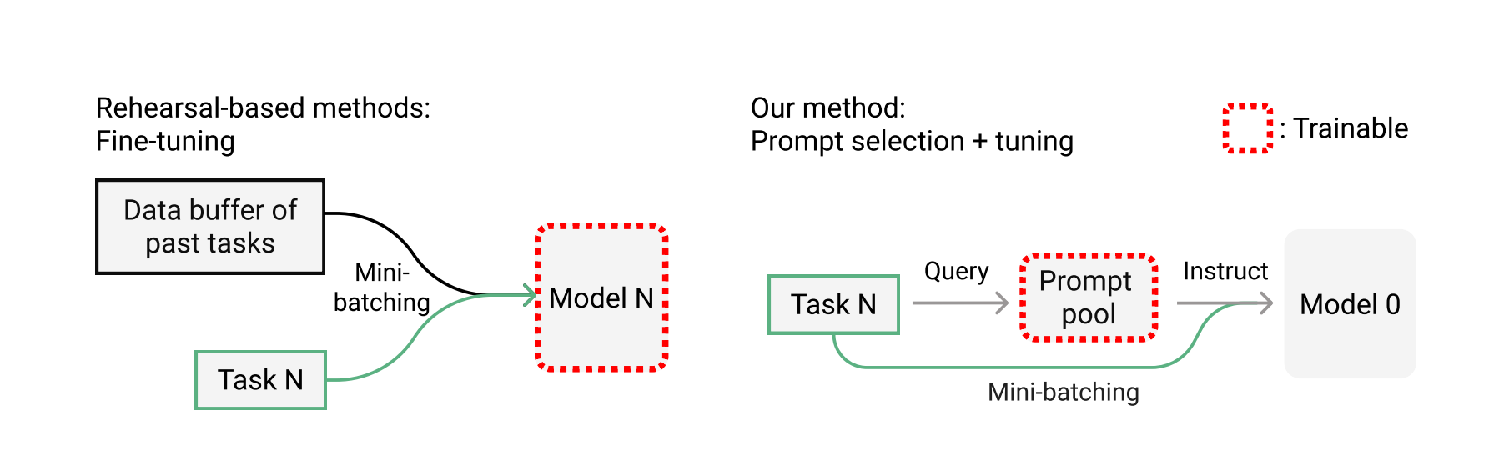
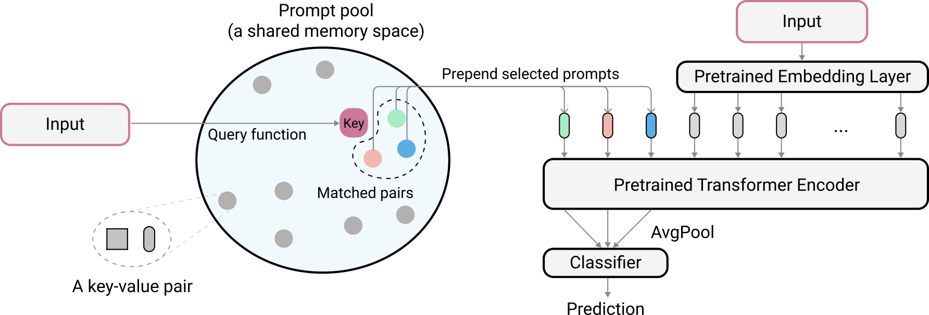
Learn to prompt
Now, we come up with more efficient knowledge preservation system for CL.
L2p for continual learning, although the model performs pretty well with rehearsal buffer it also performs well without it.
There’s no need of Task ID
Memory efficient
>So, L2p uses Learnable prompts to instruct the model for diff. tasks.
*On the left is Rehearsal Based method: where we mix the Data
buffer and current task data , here the model is trainable.
*On the right is L2p, we have frozen backbone that is pretrained
Already on something else like Imagenet.
So we don’t update the model here, but we have learnable parameters
In prompt pool.
So, whenever the task come it’ll just first query the prompt pool to choose
Learnable parameters. And to use prompt to instruct model to do prediction.
More detailed illustration. Lets say we have image i/p foe vision task. We first convert input to
specific key which is condensed representation of input by some query function.
We like the key to have some representative from the input.
So In the paper the natural choice is a pretrained transformer architecture
Credit: L2p for Continual Learning

Slide 7
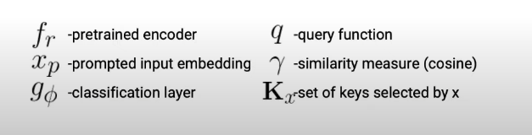
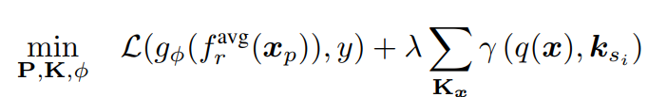
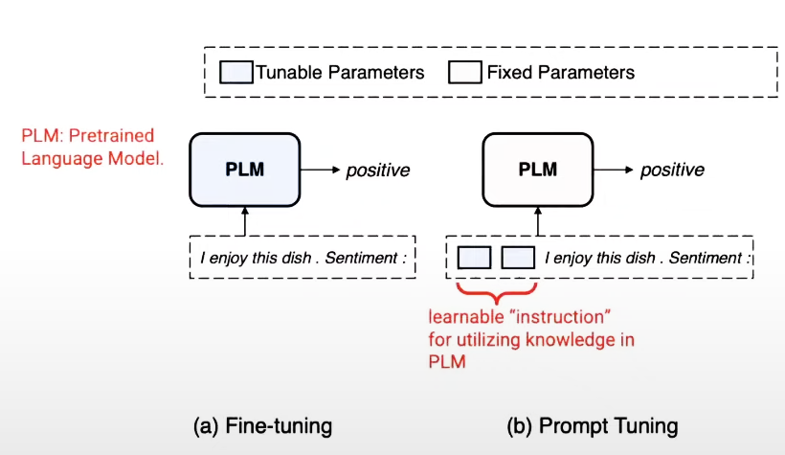
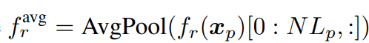
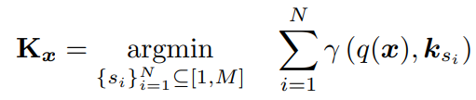
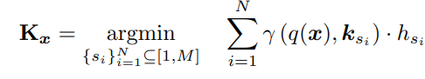
Prompt tuning and loss function
Prompt tuning converts descrete fixed prompt to continuous learnable prompts * on the left is fine tuning the whole pretrained language model n on the right is the idea of prompt tuning which is being used in L2p. The pretrained language model is fixed and we just learn the prepended prompts which are very small and easy to learn.
By fine tuning these small prepended learnable prompts it can perform very well.
*Lets move to slide 8 and will get back to the loss function.
Loss function: Here is the overall learning objective of L2p. Here the final part is just like a classification loss trying to optimize the prompt as well as final classifier.
sec part of the loss is the pool loss that optimizes the key so that every time a i/p key matches to key in prompt pool those set of chosen key will be pulled closer to the matched i/p key
*fr avg: avg pool of o/p of ViT
*his: training, normalized prompt frequency
Loss Function:
Where,
Kx represents the subset of top-N keys selected specifically for x from K
γ : R^{Dk} × R^{Dk} → R as a function to score the match between the query and prompt key

Slide 8
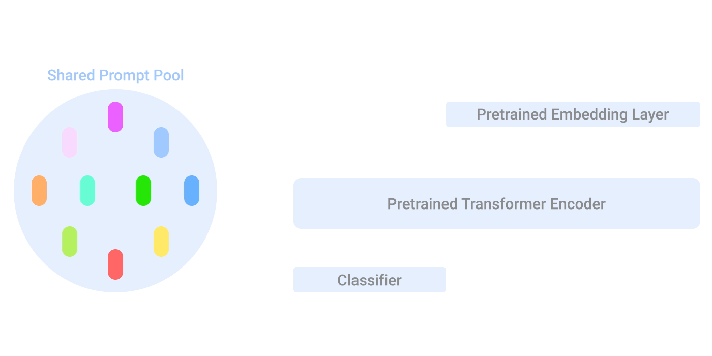

Illustration of L2p at test time
Lets address how to utilize prompting in L2p. It will internally iterate through Task A, Task B, Task C. So we can see here every time we get a task we generate query using ViT or Resnet, etc, Then use this query to choose the prompting parameters from shared prompt pool so, each i/p choose diff prompts based on query. It will just prepend this prompt to the i/p representation generated by ViT and then this will together go into pretrained transformer encoder. And finally go to the classifier for prediction. Slide 6:
Credit: Google Blog post

Slide 9
Output
cifar100
Imagenet-R
 | Acc@1 | Acc@5 | Loss
Task 1 | 84.600 | 98.000 | 0.653
Task 2 | 81.500 | 96.700 | 0.753
Task 3 | 83.000 | 97.200 | 0.657
Task 4 | 83.900 | 96.400 | 0.659
Task 5 | 88.000 | 97.500 | 0.563
Task 6 | 77.200 | 97.600 | 0.810
Task 7 | 81.400 | 96.100 | 0.726
Task 8 | 81.200 | 96.700 | 0.697
Task 9 | 87.800 | 98.500 | 0.469
Task 10 | 86.600 | 98.800 | 0.517
 | Acc@1 | Acc@5 | Loss
Task 1 | 55.538 | 74.615 | 2.132
Task 2 | 62.267 | 77.333 | 2.023
Task 3 | 52.693 | 80.796 | 2.078
Task 4 | 49.826 | 74.653 | 2.272
Task 5 | 57.263 | 76.257 | 2.146
Task 6 | 57.168 | 79.032 | 2.063
Task 7 | 54.578 | 75.045 | 2.315
Task 8 | 59.326 | 74.831 | 2.206
Task 9 | 75.120 | 86.762 | 1.501
Task 10 | 64.986 | 80.115 | 1.944
Dataset | Acc@1 | Acc@5 | Loss | Forgetting | Backward
Cifar100_l2p | 83.5200 | 97.3500 | 0.6504 | 6.7333 | -6.6000
Imagenet-R | 58.8765 | 77.9441 | 2.0681 | 8.2327 | -8.2327
Cifar100 (modified) | 81.2327 | 95.5000 | 0.6612 | 7.2575 | -6.9753

Slide 10
Limitations:
Single prompt pool
> Doesn’t replicate human brain functioning.
> Inevitable interference between task-specific and task-invariant knowledge.
Still needs rehearsal data to outperform rehearsal-based methods.
Attach prompt only at the input.
It does not acknowledge which specific task it is prone to forgetting.
Our Contribution:
L2p was not evaluated in Imagenet – R dataset, So, we evaluated and the performance was not satisfactory.
We tried individual prompt but the performance still lagging.
We further implemented Dual prompt technique which is further extension of L2p and compare the results on Imagenet-R and cifar100.
We also tried L2p on TinyImagenet but due to server issue training could not complete

Slide 11
Thank You

